Slide 1



Final Project – Crop Yield Predictor
Saúl Verdú Vicente

Slide 2
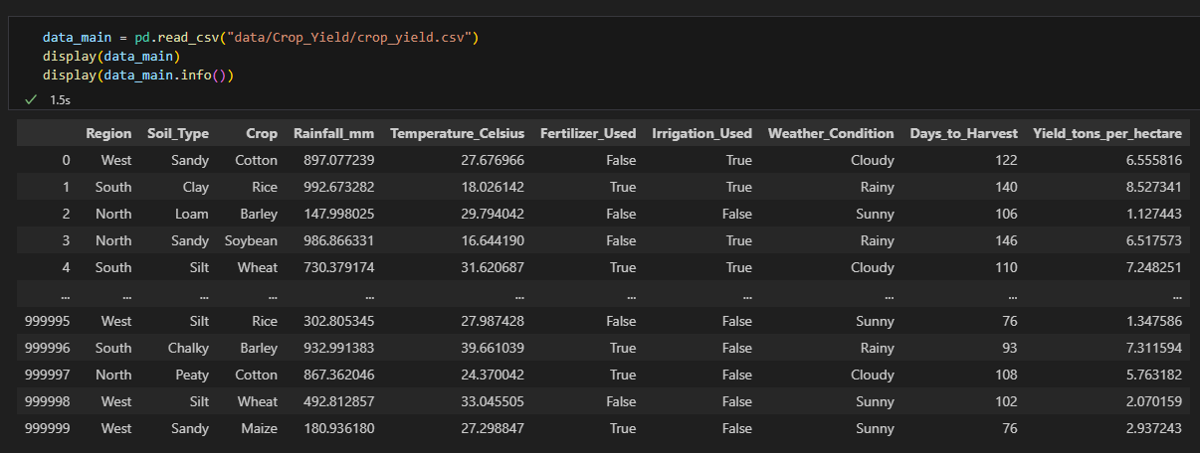
Dataset
Go to Tableau →

Slide 3
Data Preprocessing
One-hot encode
Labels

Slide 4
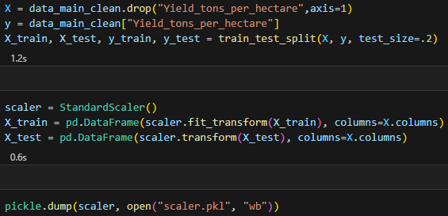
Feature Scaling

Slide 5
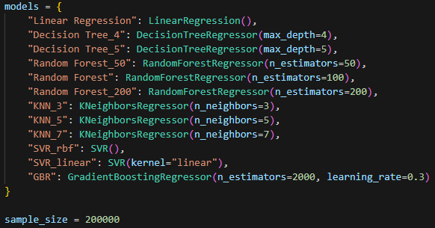

Model Selection

Slide 6
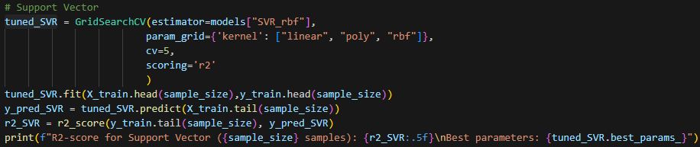
Model Selection

Slide 7
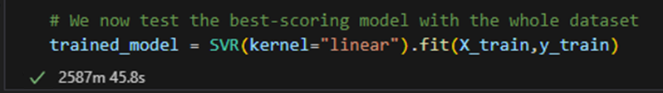
Model Training

Slide 8
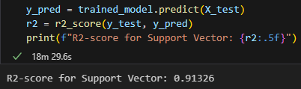
Model Evaluation

Slide 9
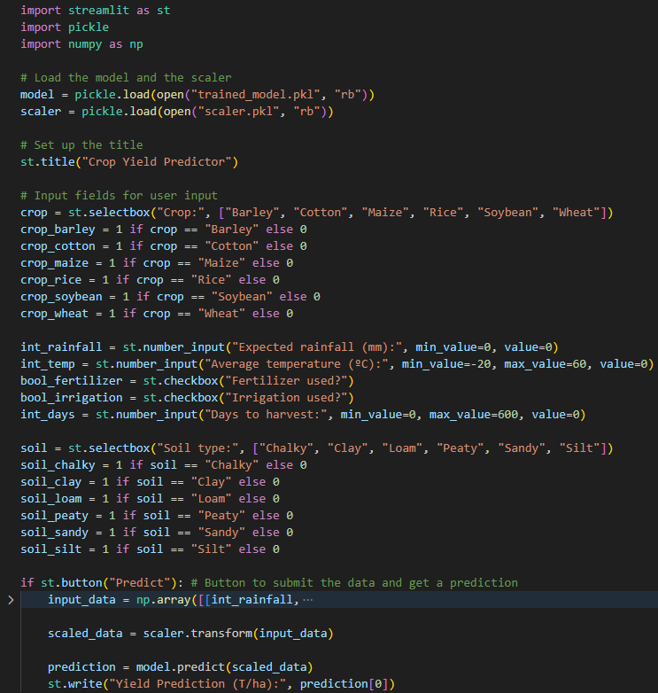
Streamlit App

